Slide 1
Women Entrepreneurs
Focus Group
11 April 2018

Slide 2
Recruitment & Methodology
Purpose
to explore experience of online channels
to discuss Business Support requirements
to examine the Role of Networks in Business
Location
Taylor McKenzie, Glasgow (11 April 2018)
Sample
Number: 6 Female Business Owners
Country: Scotland
Type: Focus Group
Customer Profile: Scottish companies, non retail, turnover > 500K, Female Business Leaders

Slide 3
Overall Summary
Up for transacting all activity on line
Scalability really important ie as their business grows they want what they can do online to match
Need the ability to upload multiple docs from electronic devices
Too many business organisations offering advice – they are unsure who to go to for what
Want business orgs to be joined up and/or refer to right place (but not having to go round the loop again)
Experts giving business support must be knowledgeable about their industry (big problem)
Companies expect conditions to be attached to funding support but needs to be fit for purpose
Targets attached to funding can be too restrictive
Networking important to them and they would be up for being approached to share advice
Need to trust those within the networks
Very clued up on our pre-pipeline and BG-SE pipeline process!

Slide 4
Online Channels
What we explored:
Online channels used
Good/Not so good sites
Types of information looked for
Online transactions undertaken
Expectations from SE

Slide 5
Online Channels
What we heard
HMRC, Gov.uk, SAGEPay, Banks used
Quickbooks “easy to use” (best website for uploading evidence, collating (mentioned in previous research)
Nest Pensions Scheme and Workplace Pensions deemed not so good
Transacting online for expenses, payrolls, buying, accounting, banking
Appetite for everything mobile and online
Wanted to electronically provide evidence
Preference for cloud storage/dropbox
Awareness of GDPR implications affecting elements of business such as payroll functions
Scaleability most important
“we were looking for something we weren’t going to grow out of”

Slide 6
CARD SORT
We asked users to undertake a card sorting exercise to group activities into themes.
Top Tasks Emerging:
Funding and grants for businesses
Help to develop new products and services
Advice and support for businesses looking to export products and services
Improve business processes with our support
New Cards Added:
Legislation
Employability and apprenticeships
Webchat
Search

Slide 7
Business Support
What we explored:
Information looked for from Business Support organisations
Where they currently go for such support
Organisations providing good support/what does that look like
Conditions attached to funding and support
Likely transactions online/SE.com

Slide 8
Business Support
What we heard
Workforce development & employability information needed
Council first port of call (local)
Gov.UK – trusted and credible
Gov.UK liked for - search bar/results, quick, fast, visibly updated
Mixed response to amount of info to view – recommend overview with option for further information if needed
Expectation that conditions will be attached to funding and services but conditions need to be tailored to the value of the support
Value added to the business cannot be easily correlated to the support provided
Effort and time to apply for funding and support often outweighs the value received
Export Information expected from SDI site
Expect accessible information for all and ability to apply online for support/services (for beta release)
“it’s the government – so would be trusted”

Slide 9
Business Support
What we heard cont
Need for one Business Information Portal
Mentoring important “it would be nice to have online access to business mentors”
Everything in one place – more alignment with other organisations
SE site should have links to all other organisations offering support (mentioned in previous research)
Contacts - “It’s about getting to know who you need to know to get about” (ref SE)
Accessing business support is challenging– asking a question doesn’t get you the information you need:
Advisors coming out to support businesses don’t have the industry expertise and experience necessary
Advisors should be upskilled to keep abreast of changing industry environments (mentioned previously).
“You need to know the solution to ask the right question”
“you would like to think the people you approach would have the knowledge”
“a lot of business advisors have never run a business”

Slide 10
SE.COM Screenshots
We then asked users to view the prototype sketches of specific journeys:
Guides Sections - needs to be higher up page
Eligibility for services made clear upfront, or signposting to other organisations who could help
I want the homepage to be tailored to me
Video – don’t want SE promotional video. Needs to be changed very regularly to show the website is keeping up to date, “videos of case studies more impact”.
Sign in – business account with multiple logins preferred
Language unclear and off putting, too much jargon
The website needs to link to all other agencies offering businesses support and funding – what can we do? Who else can fill the gaps? A portal to all types of support
Innovation important – could be upfront on site
The categories for support look right
Stats – impressive but not relevant to me
Case studies – would prefer how to help companies achieve growth within the success stories. They need to be relevant to business age, stage of journey and industry
Interactive – how can I feedback about the guides/drop downs if my industry isn’t listed? I want to add my knowledge.
“leadership and learning is clumsy”
“SPOT ON!”

Slide 11
Networks
What we explored:
The importance of networks to individuals and their business
How networks contribute towards business success
What networks they use
What constitutes good/not so good network
Willingness to answer questions/give advice to other businesses
SE initiating networking opportunities such as contact/introductions hosting/facilitating

Slide 12
Networks
What we heard
Networks were important but need to work – and be fit for purpose
FSB, Chambers, Scottish Engineering were named
Scottish Engineering seen as positive go to place for networking, industry information, trustworthy, competitors helping each other and “You don’t have to join to access the industry expertise”.
FSB mixed reports
Would be happy to offer advice and information to other like minded companies
Would not expect SE to run Peer to Peer service

Slide 13
Quotes
“I would like to think if I went to SE they would have business people with knowledge and experience to help me”
“The categories for support look right “SPOT ON”
“Can we have an ‘Are You eligible’
Section?”
“we were looking for something we weren’t going to grow out of”
“You don’t have to join to access the industry expertise”
“you need to know the solution to ask the right question”
“it’s about getting to know who you need, to know how to get about”

Slide 14
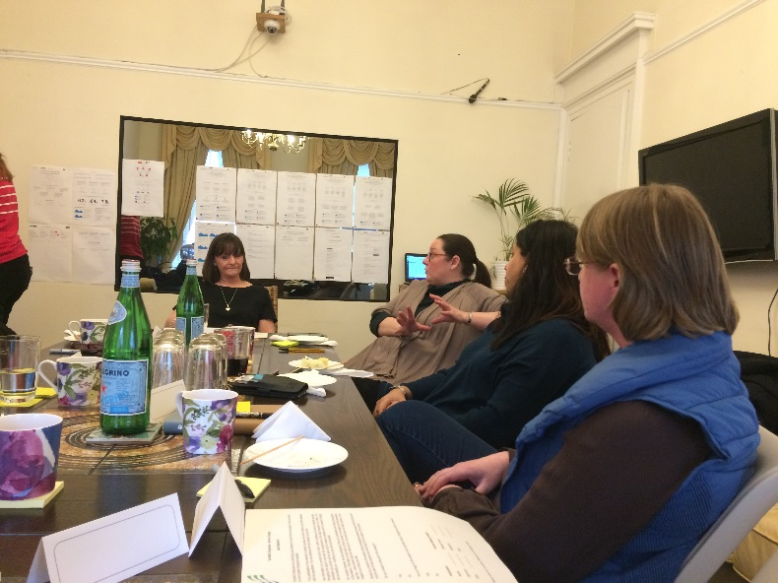
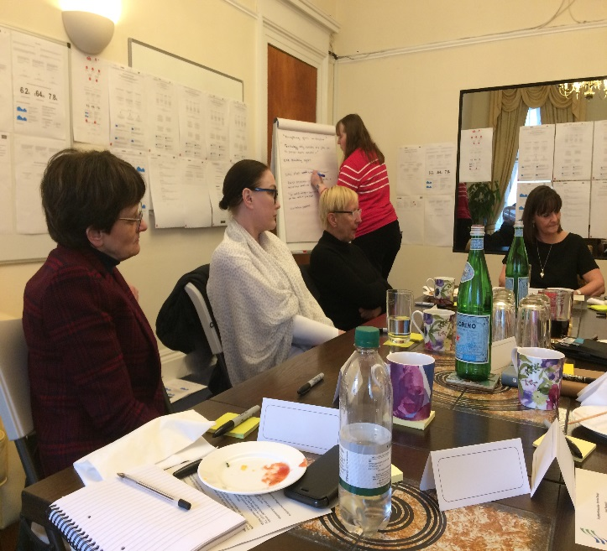
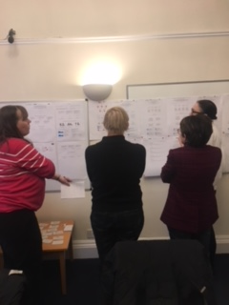
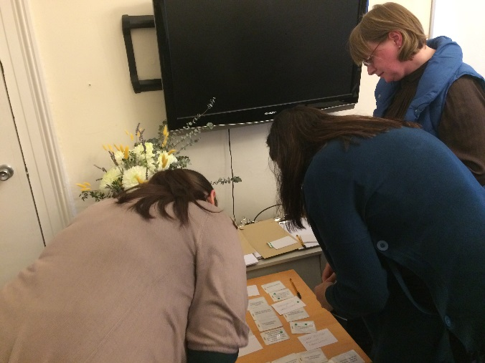
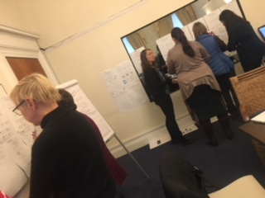
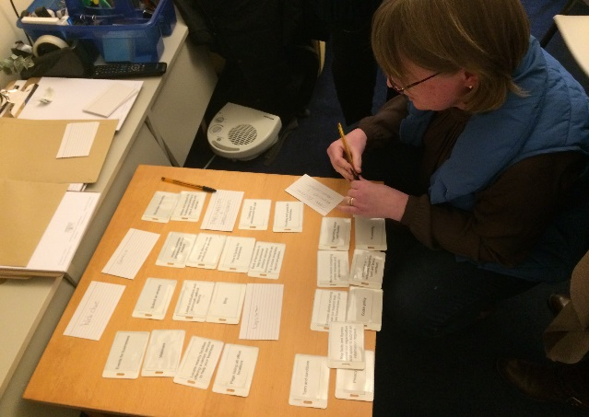
The Focus Group

